Slide 1
Employee Payroll Management System
PRESENTED BY
214 JAVA SL WQ(GROUP-2)

Slide 2
TEAM MEMBERS
NAMES
EMP ID
1. Bandi Veera Umadevi | 2488525
2. Bhadane Prashant Bhagwan | 2489036
3. Bharat Sharad Sutar | 2487767
4. Bindu K R | 2487628
5. Chamarthi Jahnavi | 2489337
6. Cheekoti Ramya | 2488932
7. Chennu Naveen Varma | 2489184
8. Chikkala Sanjan | 2488615
9. Darshan L | 2487342
10.Dayyala Anusha | 2487418

Slide 3
Agenda
Introduction.
Background of project.
Aim
Tools and Technologies.
Modules of EPM
UML diagrams.
Rest API to be build.
Testing.
Output Pictures.
Advantages.
Conclusion.

Slide 4
INTRODUCTION:
▶ The proposed project “Employee Payroll Management System” has been developed to overcome the problems faced in the practicing of manual system. This software is built to eliminate and in some cases reduce the hardships faced by the existing system. Moreover this system is designed for particular need of the company to carry out its operations in a smooth and effective manner. This web application is reduced as much as possible to avoid errors while entering data.

Slide 5
Background Of Project :
▶ Employee payroll management system is an Internet-based Java application that automates the working of a company or work center that manage and maintain records of the employees in the different department. The objective of the Employee payroll management system project is to design a scheduling system for a work center. Scheduling is such a tool with which the process of intimating activities and notifications will be easy and even online in the organization where it is installed.

Slide 6
AIM :
▶ Main aim of developing Employee Payroll Management is to provide an easy way not only to automate all functionalities involved managing leaves and Payroll for the employees of Company, but also to provide full functional reports to management of Company with the details about usage of leave facility. We are committed to bring the best way of management in the various forms of EPM. We understand that EPM in not a product to be sold, it is a tool to manage the inner operation of Company related to employee leave and Payroll.

Slide 7
Tools and Technologies:
▶ Operating system: Windows 10
▶ Front-End: Angular
▶ Server-side: Spring Boot, JPA, Hibernate.
▶ Back-end: MYSQL.
▶ Server: Tomcat.
▶ Testing: Postman, J Unit Testing.

Slide 8
Admin Module
Login to Portal
Create Admin Account
Login to Admin Account
Add/Edit/delete the employees
Add/Edit/delete the schedule employees
Add/Edit/delete mark the attendance of employees
Add/Edit/delete Leaves and employee
Add/Edit/Delete the Salary of the employee

Slide 9
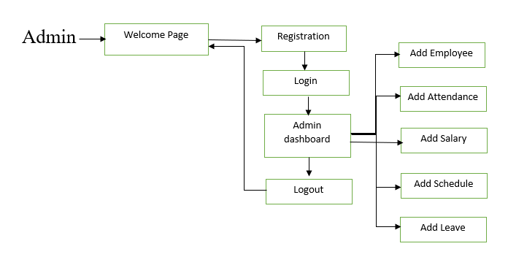
Flow Chart of Admin Module

Slide 10
Employee module
▶ Register into the application
▶ Sign into the application to maintain the record of activities.
▶ Change Password
▶ Update Profile
▶ Registration

Slide 11
Work Schedule module
Managing on work
Attendance module
Leave
Attendance
Managing Leave
Salary module
Allowance
Deduction
Pay

Slide 12
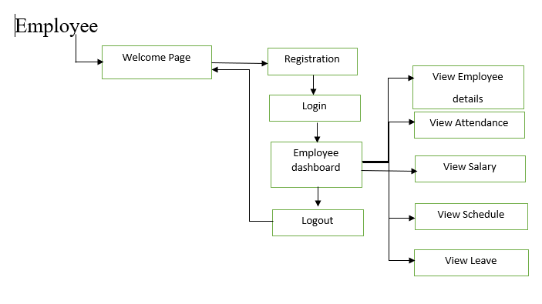
Flow Chat of Employee Module

Slide 13
REST API’s Development
Create following REST resources which are required in the application,
Creating User Entity:
Create Spring Boot with Microservices Application with Spring Data JPA
Technology stack:
Spring Boot
Spring REST
Spring Data JPA
Here will have multiple layers into the application:
Create an Entity: Employee
Create a Employee Repository interface and will make use of Spring Data JPA
Will have findByEmployeeId method.
Add the Employee details
Delete Employee By Id
Update Employee Details
Create a Employee Service class and will expose all these services.
Finally, create a EmployeeRestController will have the following Uri’s

Slide 14
2. Creating Attendance Entity:
1. Create an Entity: Attendance
2. Create a Attendance Repository interface and will make use of Spring Data JPA
a)Will have find By Employee Id method.
b) Add the Attendance details method.
c) Will have delete Employee By Id method.
d)Will have find All Employee Attendance method.
3. Create a Attendance Service class and will expose all these services.
4. Finally, create a Attendance Rest Controller will have that code in backend program.

Slide 15
3. Creating Salary Entity:
1. Create an Entity: Salary
2. Create a Salary Repository interface and will make use of Spring Data JPA
Will have find By Employee Id method.
b) Add the Salary details method.
c) Will have delete Employee By Id method.
d) Will have find All Employee Salary method.
3. Create a Salary Service class and will expose all these services.
4. Finally, create a Salary Rest Controller will have that code in backend program.

Slide 16
4. Creating Leave Entity:
1. Create an Entity: Leave
2. Create a Leave Repository interface and will make use of Spring Data JPA
a) Will have find By Employee Id method.
b) Add the Leave details method.
c) Will have delete Employee By Id method.
d) Will have find All Employee Leave method.
3. Create a Leave Service class and will expose all these services.
4. Finally, create a Leave Rest Controller will have that code in backend program.

Slide 17
Unit Testing:
Each part tested individually.
All components tested at least once.
Errors picked up earlier.
Scope is smaller, easier to fix errors.
Unit testing allows the programmer to refactor code at a later date, and make sure the module stills works correctly.
Unit testing provides faster development.

Slide 18
Functional Testing:
It is a type of software testing that validates the software system against the functional requirements.
The purpose of functional tests is to test each function of the software application.
This testing can be done either manually or using automation
The prime objective of functional testing is checking the functionalities of the software system

Slide 19
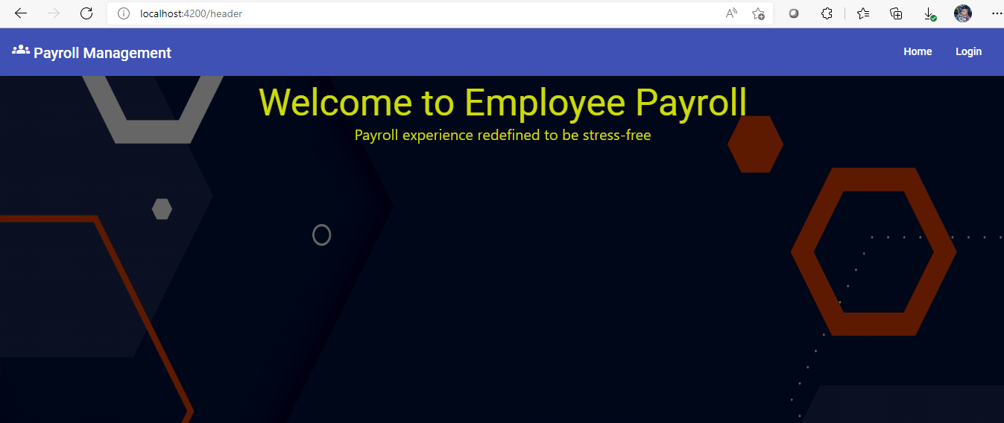
Project output Screenshots
Home page

Slide 20
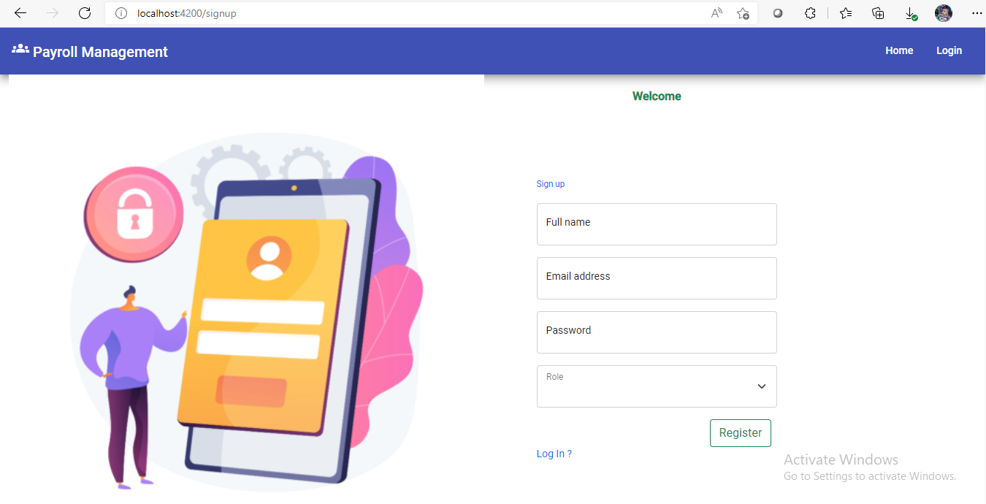
Sign Page

Slide 21
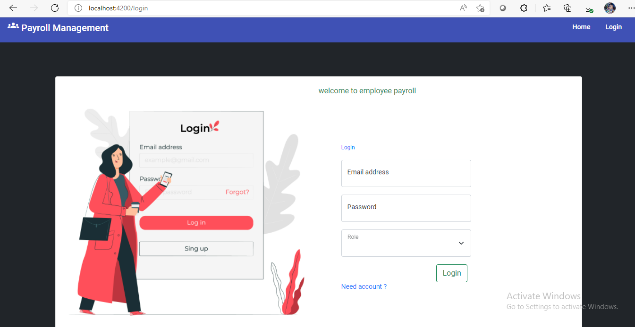
Login Page

Slide 22
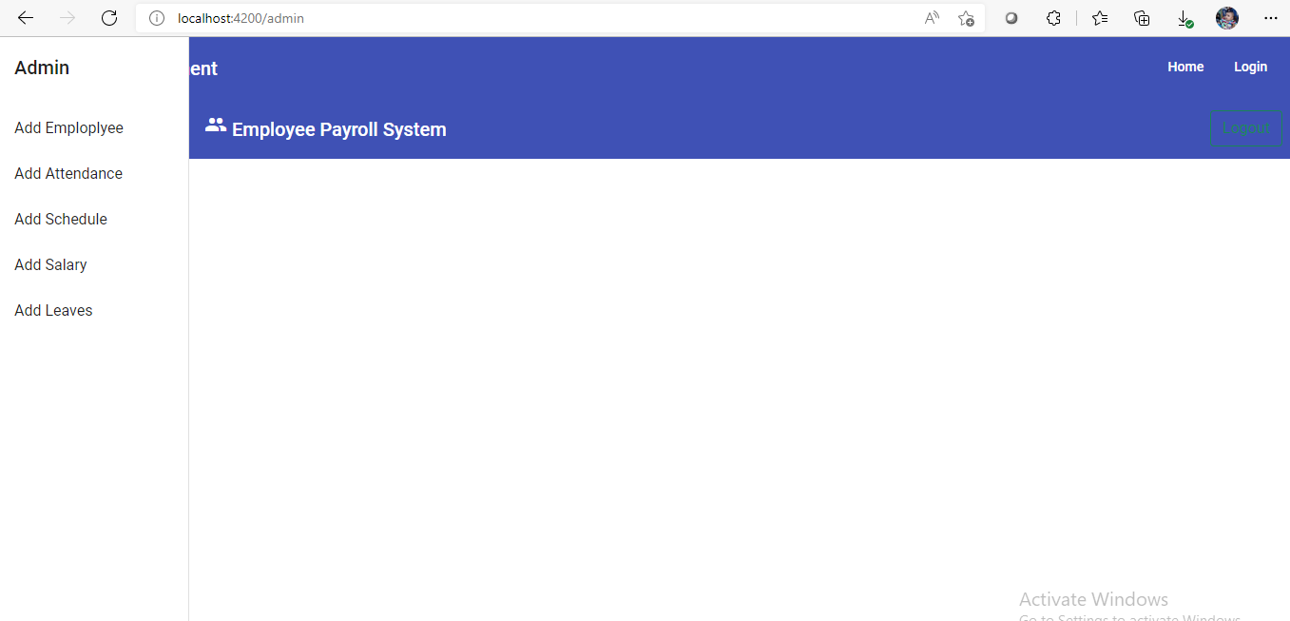
Admin Dashboard

Slide 23
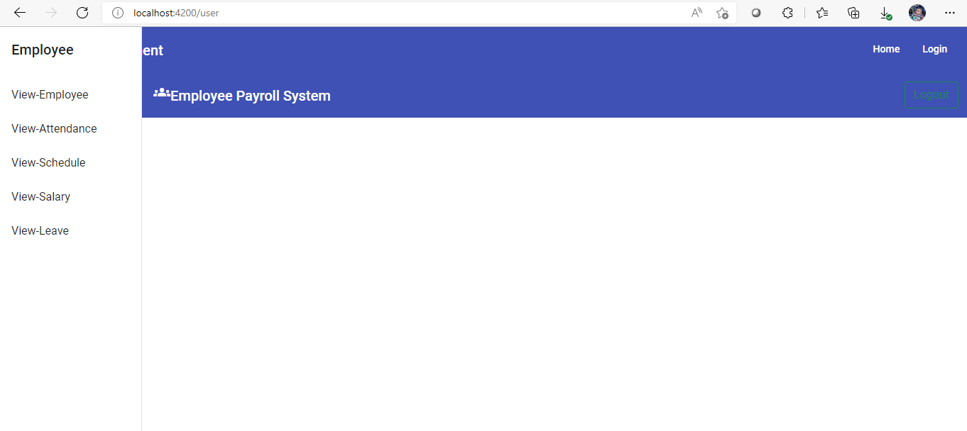
Employee Dashboard

Slide 24
Advantages Of EPM:
Helps the employee easy way to access their data.
Easy way of login and update the profile.
The information related to employee can be added and removed easily.
Reduce the burden of compliance
Store the end-to-end data of the employees

Slide 25
Conclusion:
This project is built keeping in mind that it is to be used by only one user that is the admin. It is built for use in small scale organization where the number of employees is limited. According to the requested requirement the admin can add, manipulate, update and delete all employee data in his organization. The admin can add new departments and delete them. The records can be seen by admin at any time.

Slide 26
THANK YOU

